Slide 1
BRITISH AIRWAYS AIRLINE ANALYSIS
IN-DEPTH ANALYSIS OF BRITISH AIRWAYS CUSTOMER REVIEWS
FORTUNE NWANWKO [THE WEIRD ANALYST]

Slide 2
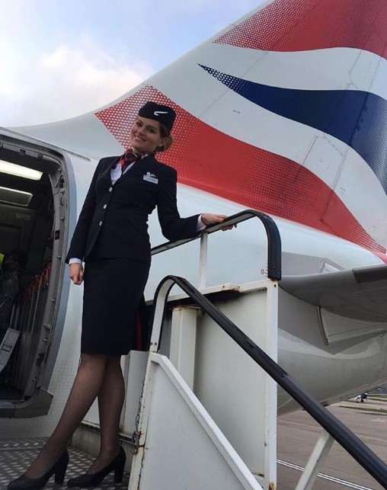
Project recap
British Airways is the biggest airline in the UK and also the flag carrier airline in the UK. Every day thousands of BA flights arrive and depart from the UK, carrying customers across the world
British Airways relies heavily on customer feedback to improve customer experience.
I have been tasked to do the following
Scrape data containing customer feedback from an independent website
Perform analysis of the data
Present findings to stakeholders

Slide 3
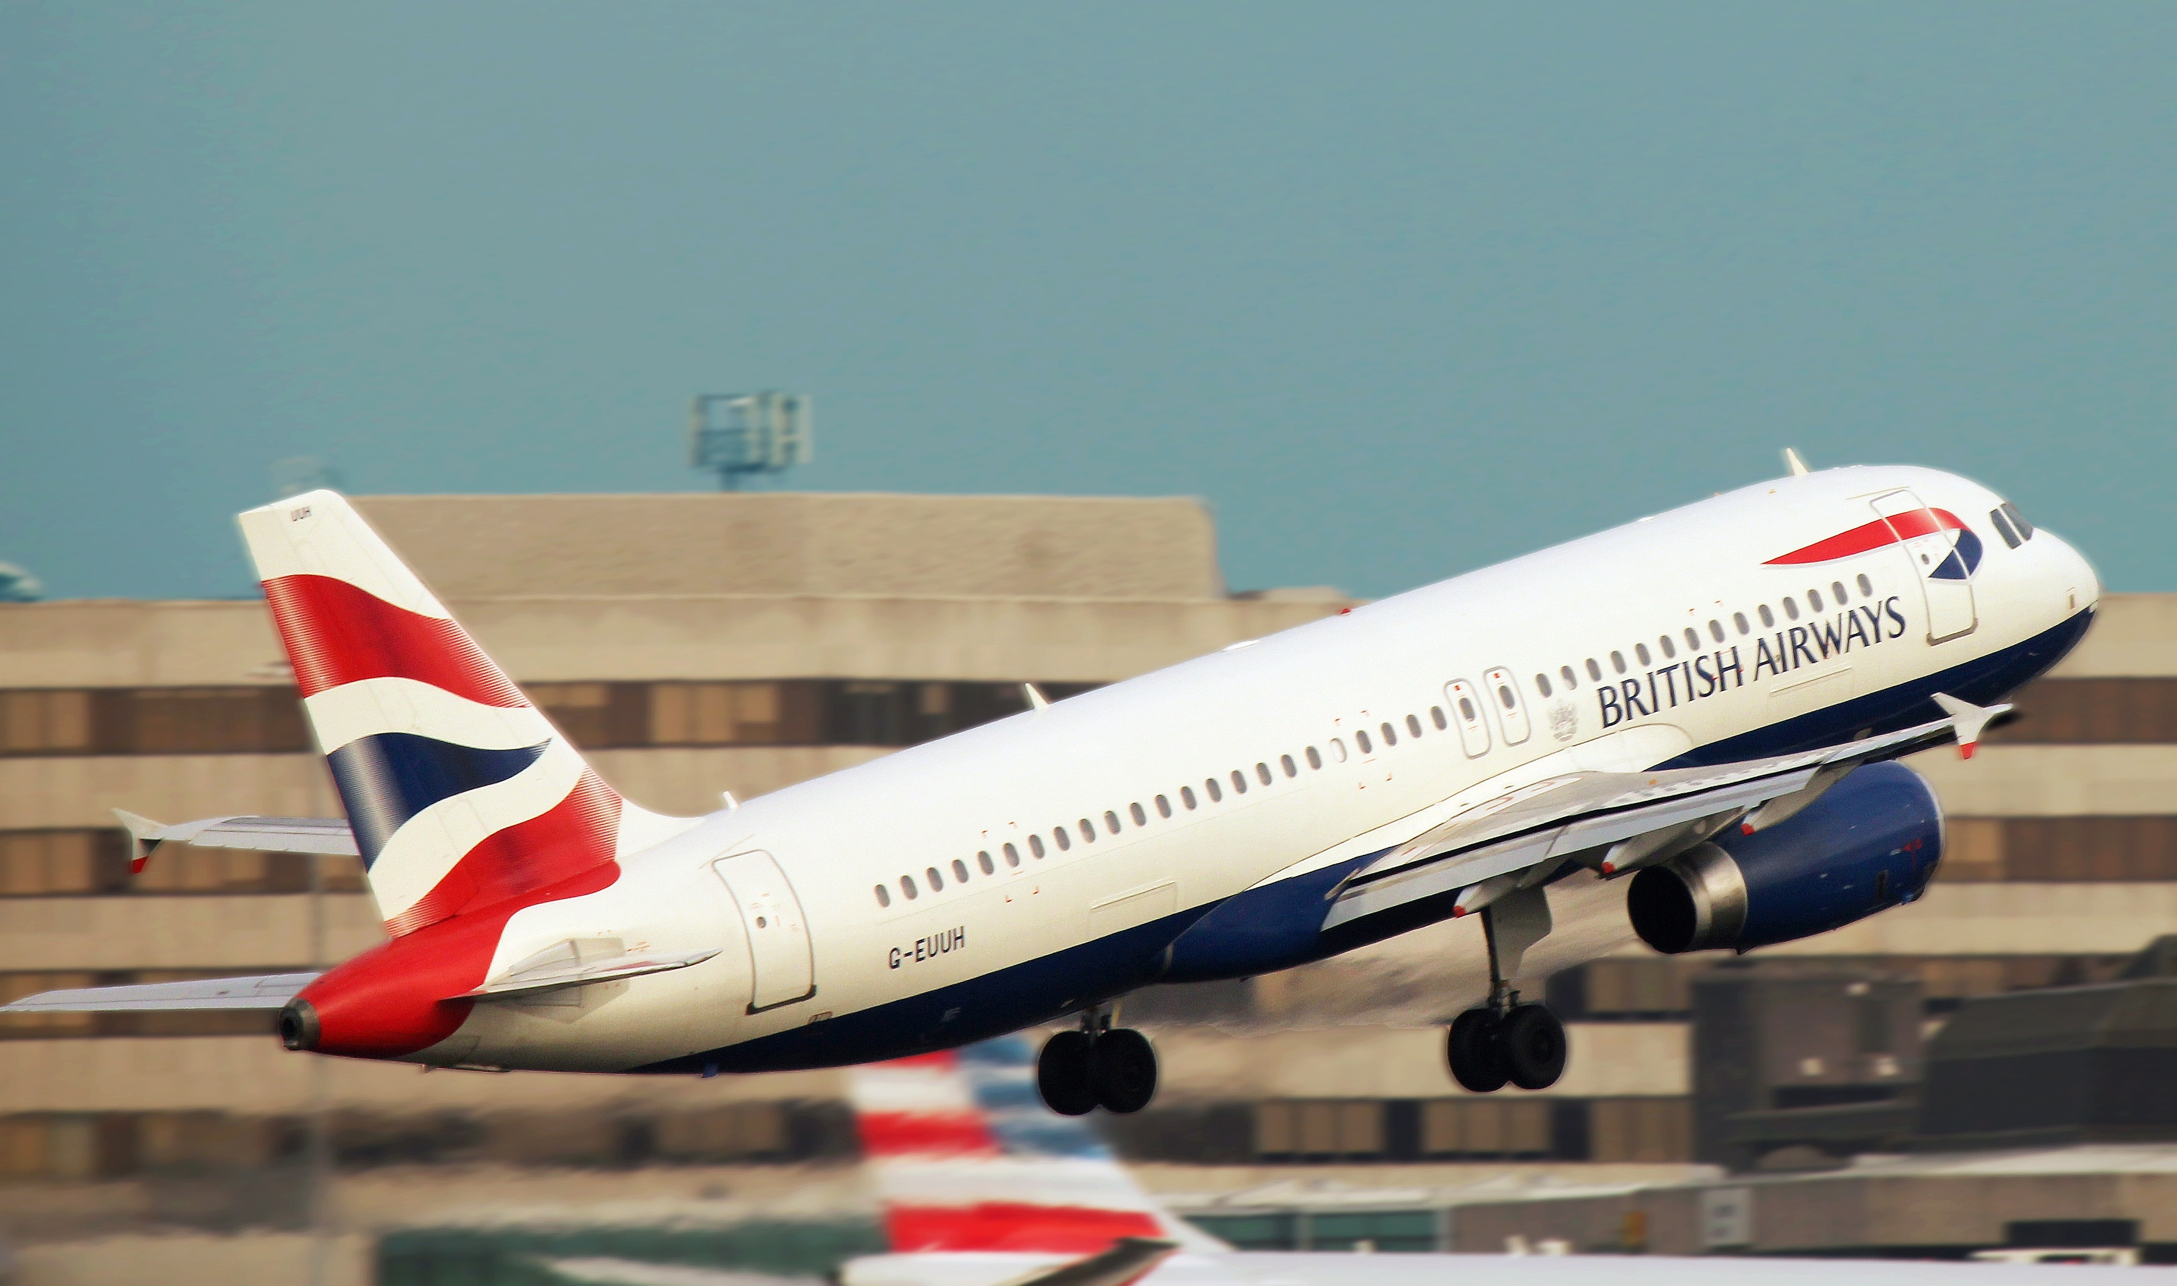
PROBLEM
Thousands of flights daily arriving and depart from the UK, carrying customers around the world.
How do we cater to customer needs?
How do we reduce costs and increase revenue?
Are our top-class customers happy with our services?

Slide 4
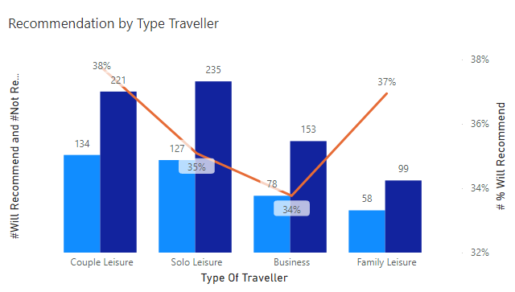
RECOMMENDATION BY TYPE OF TRAVELLERS
According to my analysis, a customer is 36 per cent likely to recommend British Airways Airline to another person or company.
Couples travelling for leisure purposes are most likely to recommend BA Airlines at 38%.
Customers travelling for business purposes are least likely to recommend BA Airlines at 34% falling 2% short of the average.
Other customers include Solo Leisure at 35% and Family leisure at 37%

Slide 5
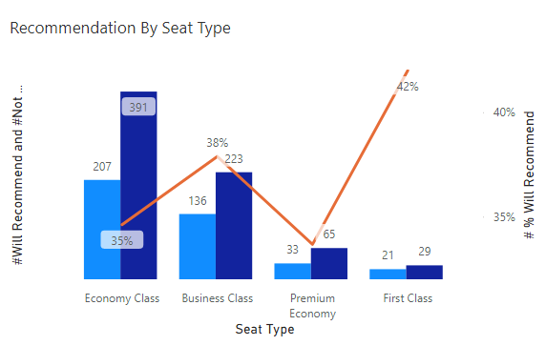
RECOMMENDATION BY SEAT TYPE
According to the data, first-class passengers are the most likely to recommend BA Airlines with 42% which is 6% above average.
Premium Economy passengers are the least likely to recommend BA Airlines with 34% which is 2% below the average.
Other Seat-Types include Economy class at 35% and Business-class at 38%

Slide 6
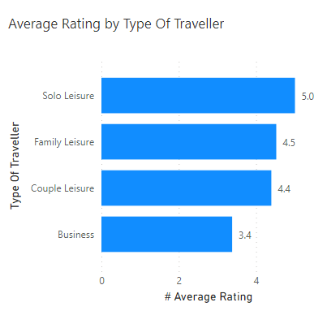
RATINGS BY TRAVELLER TYPE
British Airways Airline has an average rating of 4.4/10
Customers travelling for leisure purposes, in general, gave BA Airlines pretty strong ratings with Solo leisure having the highest rating at 5.0/10, Family leisure having an average rating of 4.5 and Couple leisure having an average rating of 4.4/10 which is equal to the average ratings for BA Airlines.
Customers travelling for Business Purposes gave BA Airlines a poor rating at 3.4/10 which is 1 point below the average rating

Slide 7
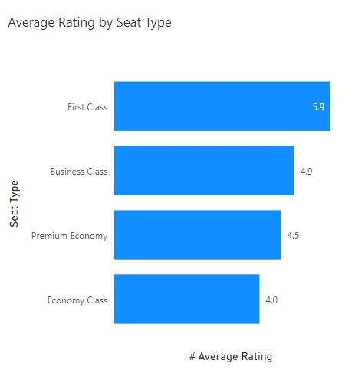
RATINGS BY SEAT TYPE
First Class and Business Class passengers seem to love BA Airlines very much with respective average ratings of 5.9/10 and 4.9/10.
The Premium economy class also have an average rating of 4.5/10 which is 0.1 points above the average rating.
The Economy class has the least rating with 4.0/10 which is 4 points below the average rating.

Slide 8
SUMMARY
ANALYSIS
Customers are 36% likely to recommend British Airways Airlines to other people with First Class customers having a recommendation likelihood at 42%.
INSIGHTS
First Class customers have the highest recommendation rate and highest rating compared to the other seat type. This shows that on average first-class customers get value for their money. You could further try to improve the perks a first-class customer gets to improve customer experience
Customers travelling for leisure purposes tend to enjoy BA Airlines the most with an average of 4.7/10 ratings and are 37% per cent likely to recommend BA Airlines. To further improve leisure customers’ experience BA can add some additional perks for tourists such as discount prices to tourist locations. In addition, BA can also work with tourist companies.
Customers travelling for Business purposes do not seem to like BA Airlines that much, this could be because the majority of them (over 70%) travel with Economy class which also has the least rating when compared to other seat types. To improve this BA can improve their rescheduling since Business travellers tend to reschedule a lot and also reduce or remove service fees for rescheduling. BA can also give better discounts for to and fro tickets. The Economy class can also be improved by adding extra legroom and also other small amenities such as cup holders to seats.
Hopefully, this analysis will help BA to improve customer experience and also increase revenue.

